Slide 1
Characterising a posterior distribution
Model Fitting and Inference for
Infectious Disease Dynamics
short course

Slide 2
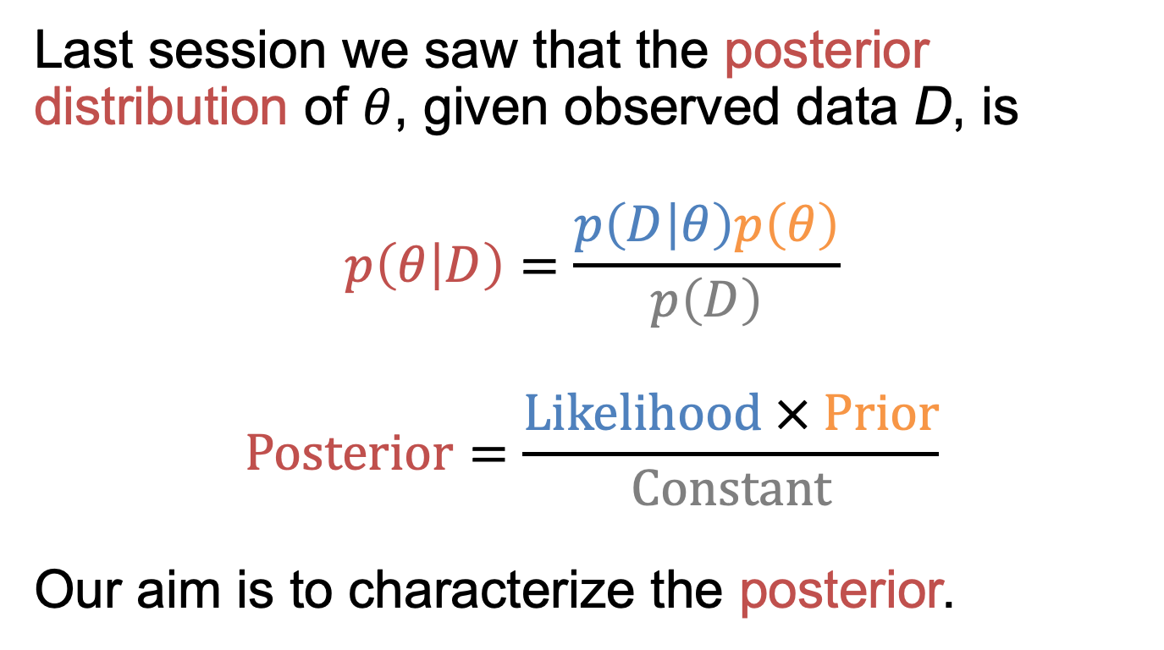
Recap
Last session we saw that the posterior distribution of $θ$, given observed data D, is
$$p\left(θ | D\right)=\frac{p\left(D | θ\right)p\left(θ\right)}{p\left(D\right)}$$
$$Posterior=\frac{Likelihood × Prior}{Constant}$$
Our aim is to characterize the posterior.

Slide 3
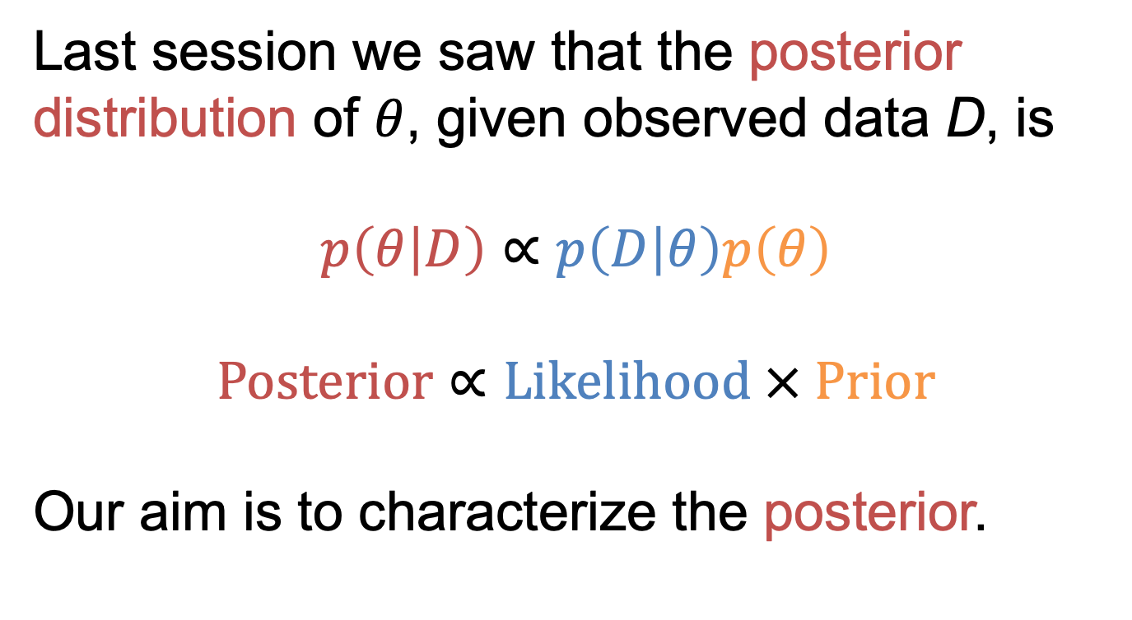
Recap
Last session we saw that the posterior distribution of $θ$, given observed data D, is
$$p\left(θ | D\right)∝p\left(D | θ\right)p\left(θ\right)$$
$$Posterior∝Likelihood × Prior$$
Our aim is to characterize the posterior.

Slide 4
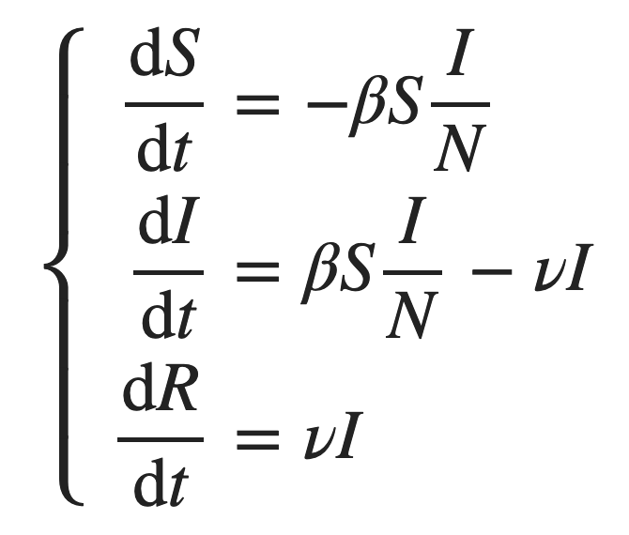


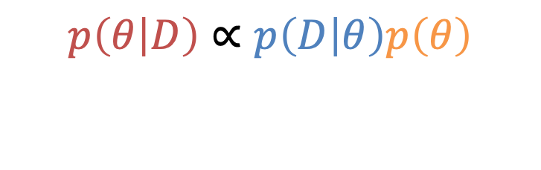

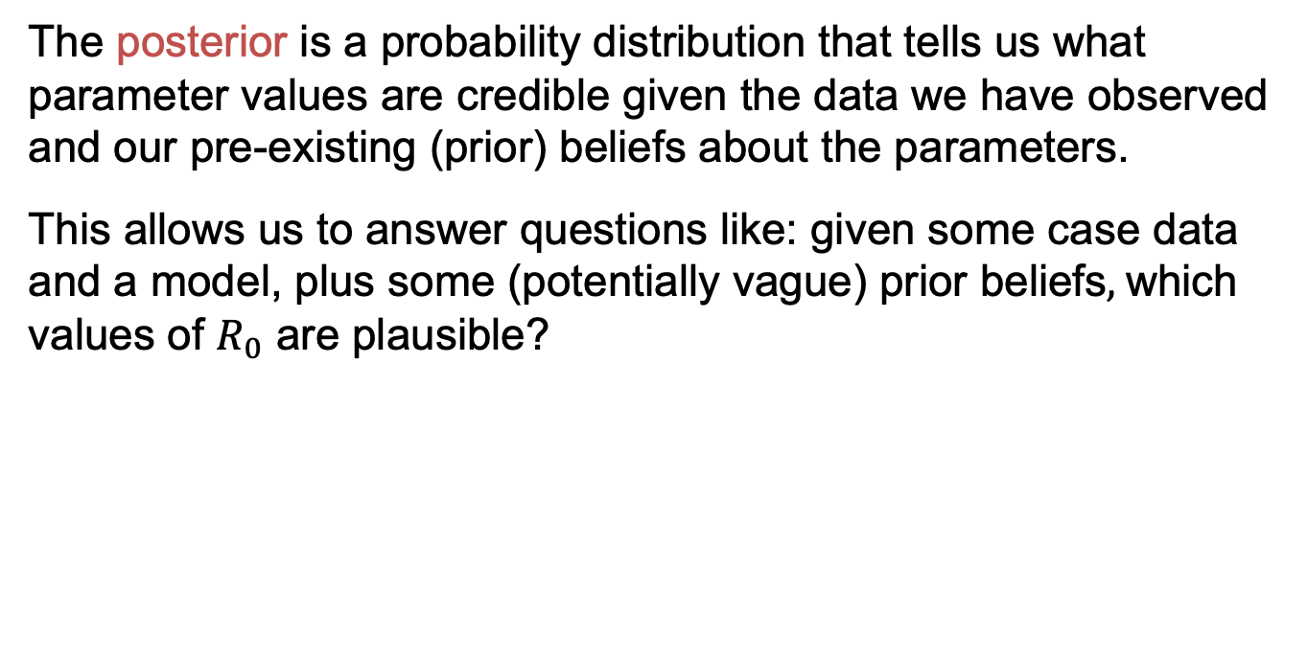

Recap
$$p\left(θ | D\right)∝p\left(D | θ\right)p\left(θ\right)$$
$$Posterior∝Likelihood×Prior$$
The posterior is a probability distribution that tells us what parameter values are credible given the data we have observed and our pre-existing (prior) beliefs about the parameters.
This allows us to answer questions like: given some case data and a model, plus some (potentially vague) prior beliefs$,$which values of $R_{0}$ are plausible?
Data and model
→
+ Prior beliefs
$$R_{0}\sim U(1,2)$$
$$R_{0}=β/ν$$
Posterior for $R_{0}$

Slide 5
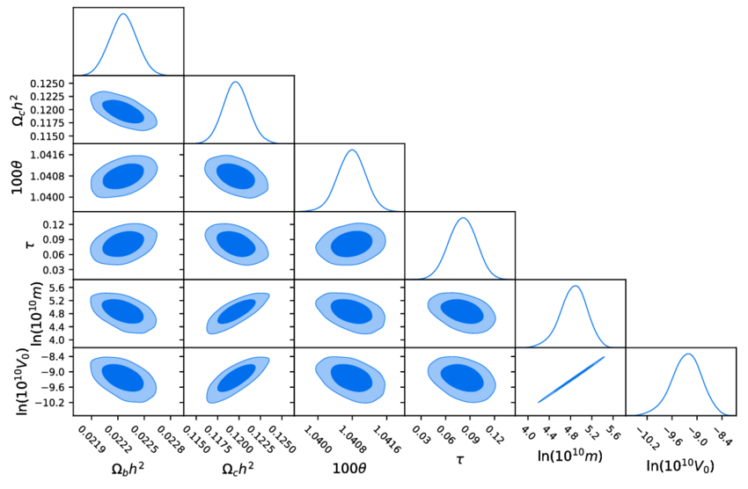
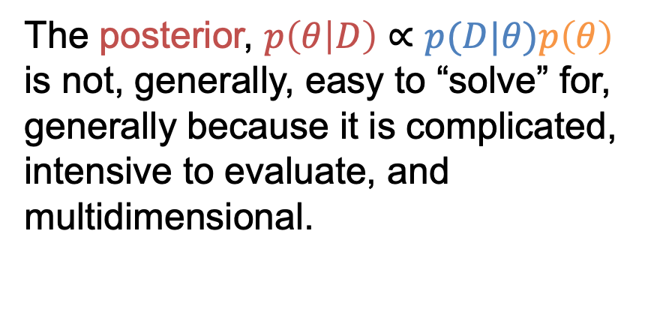
The problem
The posterior, $p\left(θ | D\right)∝p(D|θ)p\left(θ\right)$ is not, generally, easy to “solve” for, generally because it is complicated, intensive to evaluate, and multidimensional.
Iqbal et al. (2018) Astrophysics and Space Science 10.1007/s10509-018-3446-3.

Slide 6
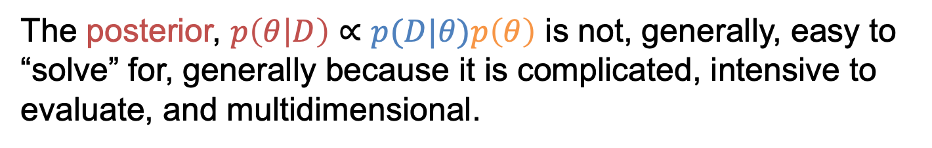
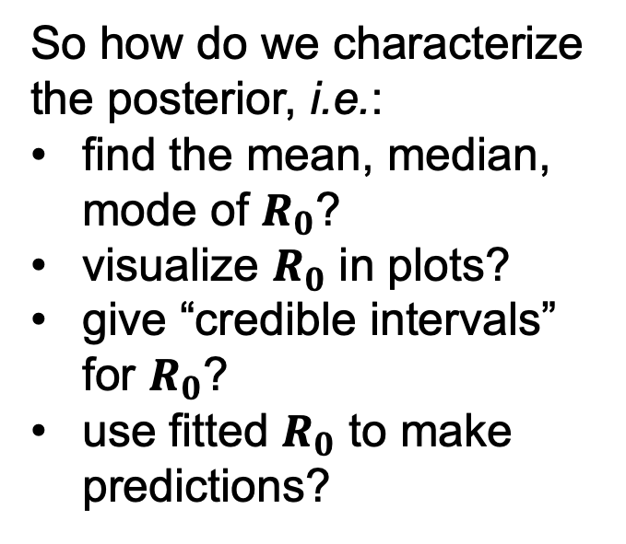

The problem
The posterior, $p\left(θ | D\right)∝p(D|θ)p\left(θ\right)$ is not, generally, easy to “solve” for, generally because it is complicated, intensive to evaluate, and multidimensional.
So how do we characterize the posterior, i.e.:
find the mean, median, mode of $R_{0}$?
visualize $R_{0}$ in plots?
give “credible intervals” for $R_{0}$?
use fitted $R_{0}$ to make predictions?
$$R_{0}$$

Slide 7
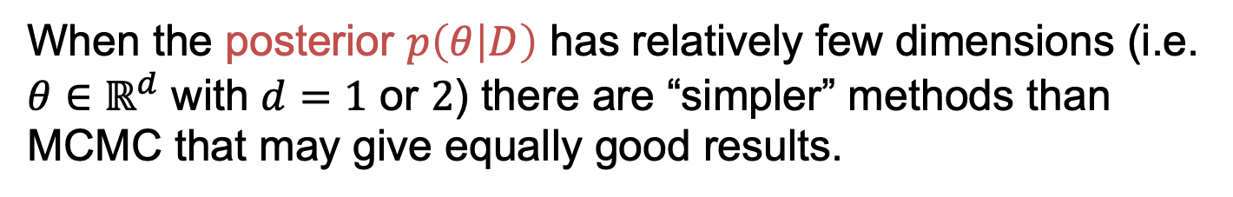
Methods suitable in low dimensions
When the posterior $p\left(θ | D\right)$ has relatively few dimensions (i.e. $θ∈ℝ^{d}$ with $d=1$ or $2$) there are “simpler” methods than MCMC that may give equally good results.
We will start by exploring two such methods:
grid approximation
rejection sampling
$$R_{0}$$

Slide 8

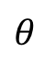
Method 1: Grid approximation
$$f\left(θ\right)$$
$$θ$$
Notes:
Distribution might be complicated, it might be computationally prohibitive to characterise the whole thing

Slide 9
Method 1: Grid approximation
mode: “highest” point
plot: draw a line
between points
$$f\left(θ\right)$$
$$θ$$
Notes:
Distribution might be complicated, it might be computationally prohibitive to characterise the whole thing

Slide 10
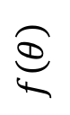
Method 2: Rejection sampling
$$f\left(θ\right)$$
$$θ$$

Slide 11
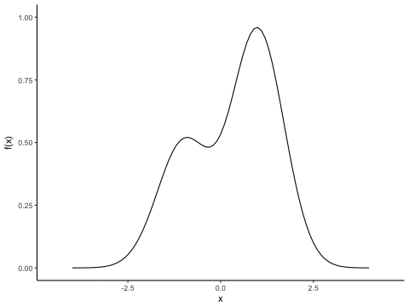
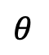
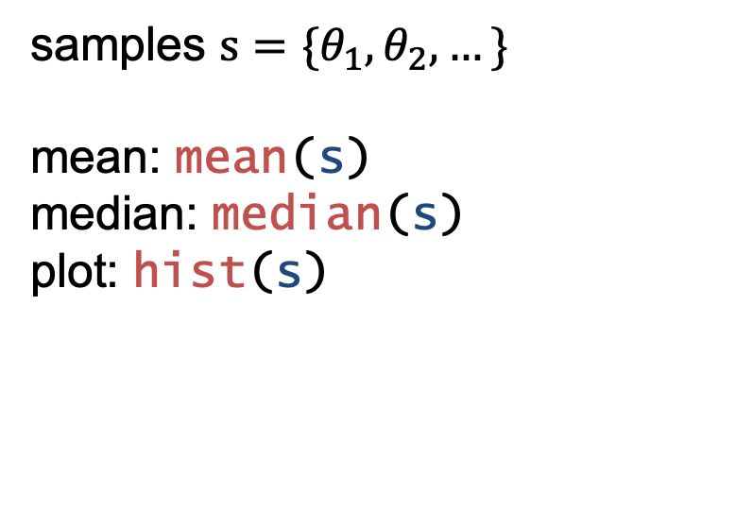
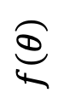
Method 2: Rejection sampling
samples $s=\{θ_{1},θ_{2},…\}$
mean: mean(s)
median: median(s)
plot: hist(s)
$$f\left(θ\right)$$
$$θ$$

Slide 12
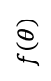
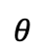
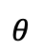

Practical, part 1
$$f\left(θ\right)$$
$$f\left(θ\right)$$
$$θ$$
$$θ$$
Start the practical:
“Grid approximation” and “Rejection sampling” in the MCMC session
Notes:
Distribution might be complicated, it might be computationally prohibitive to characterise the whole thing

Slide 13
Practical 1
How much do the summary statistics change if you perform the sampling again?
If you decrease the number of attempts from 1000 to 100, would you expect the summary statistics to change more each time sampling is performed or less? What does this tell you about reliable sampling?
What are the advantages and disadvantages of grid approximation versus rejection sampling?

Slide 14
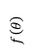
Issues with grid / rejection methods
Need to specify the limits of the distribution
As dimensions increase: Curse of dimensionality
$$f\left(θ\right)$$
$$θ$$

Slide 15
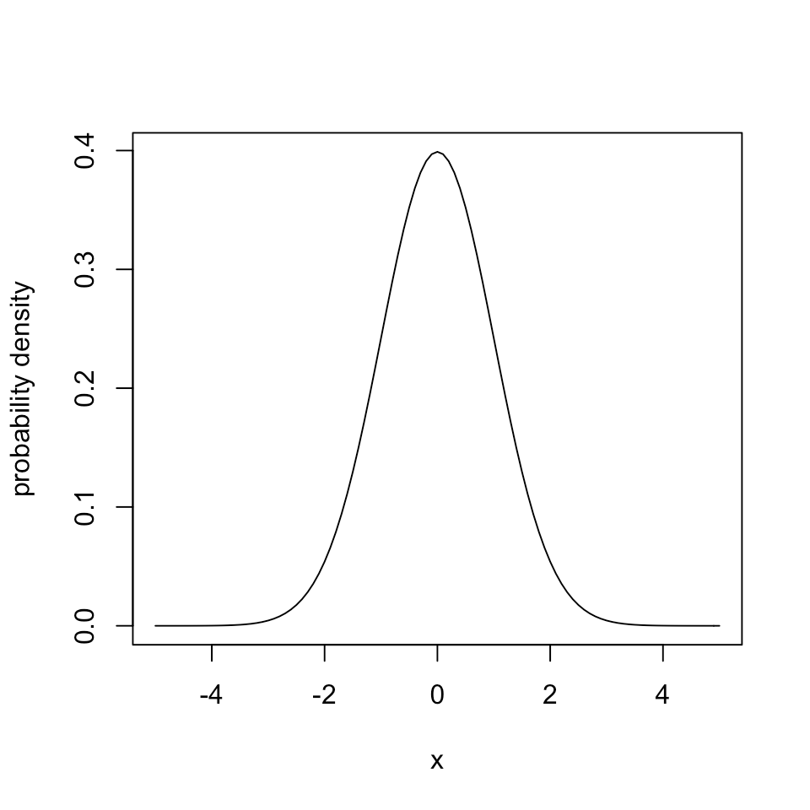
Curse of dimensionality
Throwing darts at the standard normal distribution between -4*SD and 4*SD:
Fraction 0.31 will “hit”

Slide 16
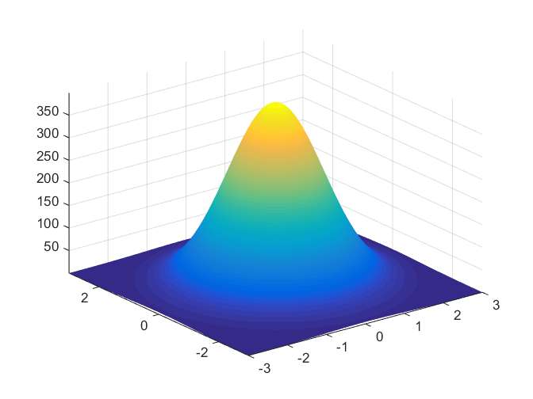
Curse of dimensionality
2D normal distribution:
0.31² = 0.098
10D normal distribution:
0.31¹⁰ = 0.0000091
(to get 1000 samples, you need to throw 110 million darts... and that’s when limits are known)

Slide 17
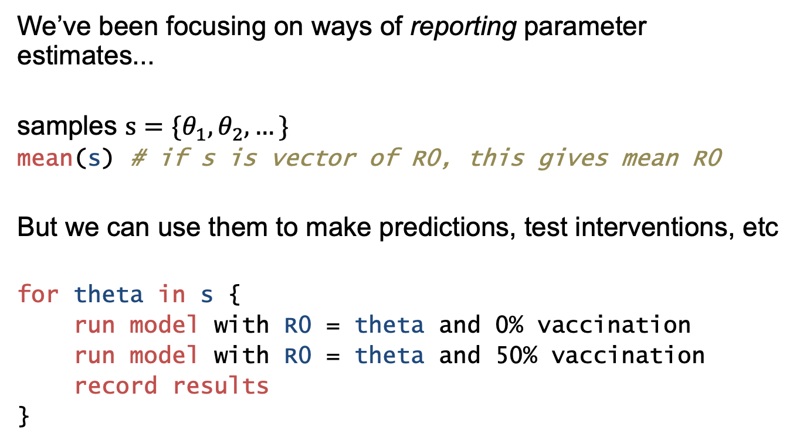
What can we do with posterior samples?
We’ve been focusing on ways of reporting parameter estimates...
samples $s=\{θ_{1},θ_{2},…\}$
mean(s) # if s is vector of R0, this gives mean R0
But we can use them to make predictions, test interventions, etc
for theta in s {
run model with R0 = theta and 0% vaccination
run model with R0 = theta and 50% vaccination
record results
}

Slide 18
Markov Chain Monte Carlo
Model Fitting and Inference for
Infectious Disease Dynamics
short course

Slide 19
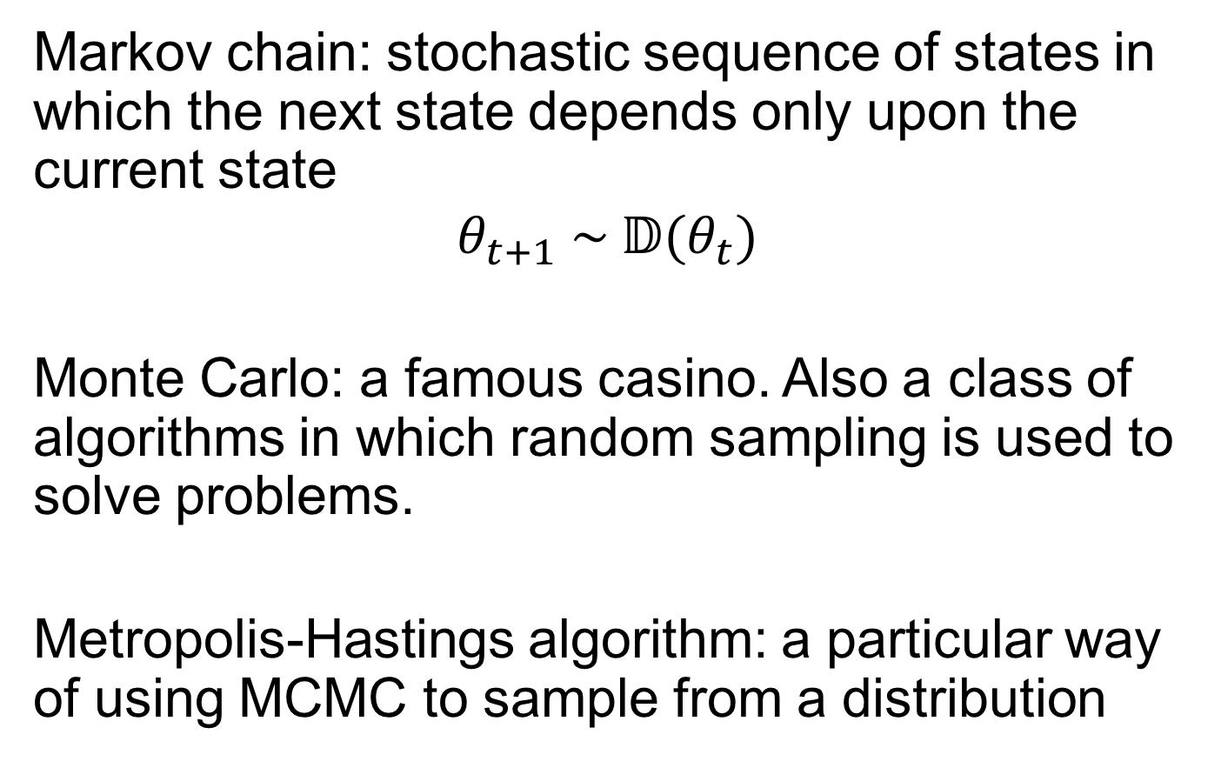
Markov Chain Monte Carlo (MCMC)
Markov chain: stochastic sequence of states in which the next state depends only upon the current state
$$θ_{t+1} \sim 𝔻(θ_{t})$$
Monte Carlo: a famous casino. Also a class of algorithms in which random sampling is used to solve problems.
Metropolis-Hastings algorithm: a particular way of using MCMC to sample from a distribution

Slide 20
MCMC: Outline
What the algorithm is
Practical: Implementing Metropolis-Hastings MCMC
Why it works.
Notes:
to avoid intimidation

Slide 21
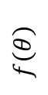
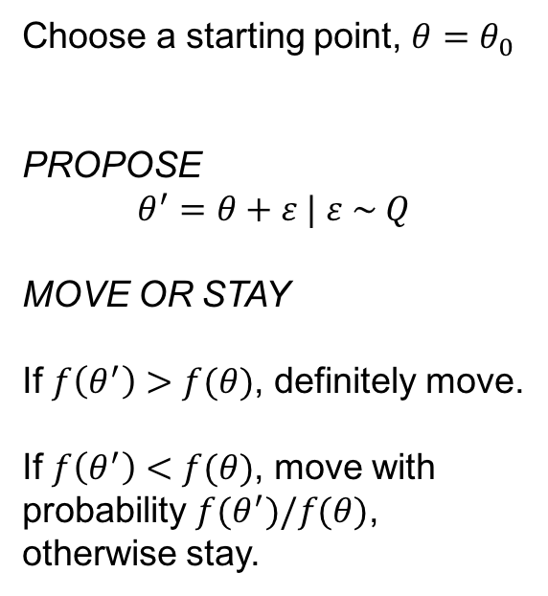
MCMC algorithm
Choose a starting point, $θ=θ_{0}$
PROPOSE
$$θ^{′}=θ+ε | ε \sim Q$$
MOVE OR STAY
If $f\left(θ^{′}\right)>f(θ)$, definitely move.
If $f\left(θ^{′}\right)<f(θ)$, move with probability $f(θ^{′})/f(θ)$, otherwise stay.
$$f\left(θ\right)$$
$$θ$$
PROPOSE
MOVE OR STAY (“acceptance”)
SAVE LOCATION
Notes:
three steps first

Slide 22
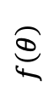
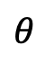
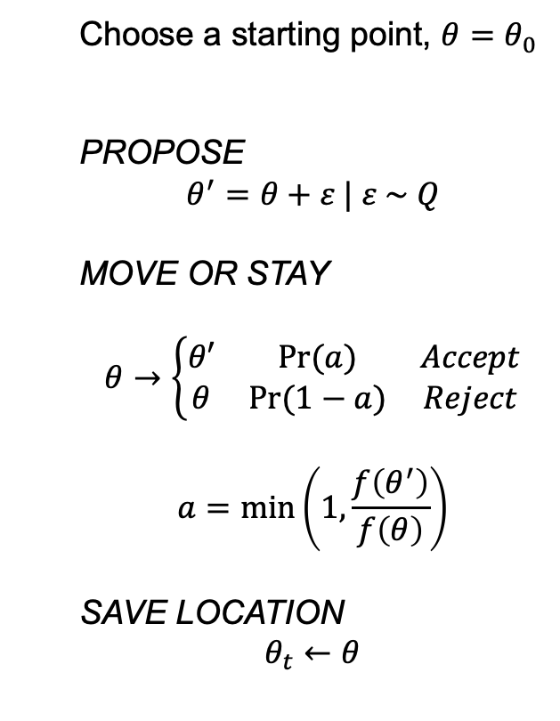
MCMC algorithm
Choose a starting point, $θ=θ_{0}$
PROPOSE
$$θ^{′}=θ+ε | ε \sim Q$$
MOVE OR STAY
$$θ→\left\{\begin{matrix}θ′ & Pr⁡(a) & Accept \\ θ & Pr⁡(1−a) & Reject\end{matrix}\right.$$
$$a=\min\left(1,\frac{f\left(θ^{′}\right)}{f\left(θ\right)}\right)$$
SAVE LOCATION
$$θ_{t}←θ$$
$$f\left(θ\right)$$
$$θ$$
PROPOSE
MOVE OR STAY (“acceptance”)
SAVE LOCATION

Slide 23



Choose a starting point, $θ=θ_{0}$
PROPOSE
$$θ^{′}=θ+ε | ε \sim Q$$
MOVE OR STAY
$$θ→\left\{\begin{matrix}θ′ & Pr⁡(a) & Accept \\ θ & Pr⁡(1−a) & Reject\end{matrix}\right.$$
$$a=\min\left(1,\frac{f\left(θ^{′}\right)}{f\left(θ\right)}\right)$$
SAVE LOCATION
$$θ_{t}←θ$$
“Metropolis”
acceptance ratio!

Slide 24
MCMC algorithm
Choose a starting point, $θ=θ_{0}$
PROPOSE
$$θ^{′}=θ+ε | ε \sim Q$$
MOVE OR STAY
$$θ→\left\{\begin{matrix}θ′ & Pr⁡(a) & Accept \\ θ & Pr⁡(1−a) & Reject\end{matrix}\right.$$
$$a=\min\left(1,\frac{f\left(θ^{′}\right)}{f\left(θ\right)}\right)$$
SAVE LOCATION
$$θ_{t}←θ$$
$$f\left(θ\right)$$
$$θ$$
PROPOSE
MOVE OR STAY (“acceptance”)
SAVE LOCATION

Slide 25
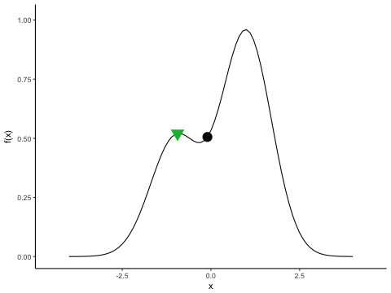
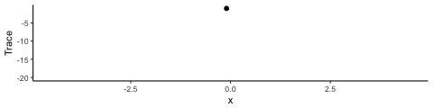
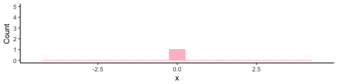
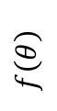
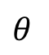
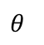
$$f\left(θ\right)$$
$$θ$$
$$θ$$
$$θ$$

Slide 26
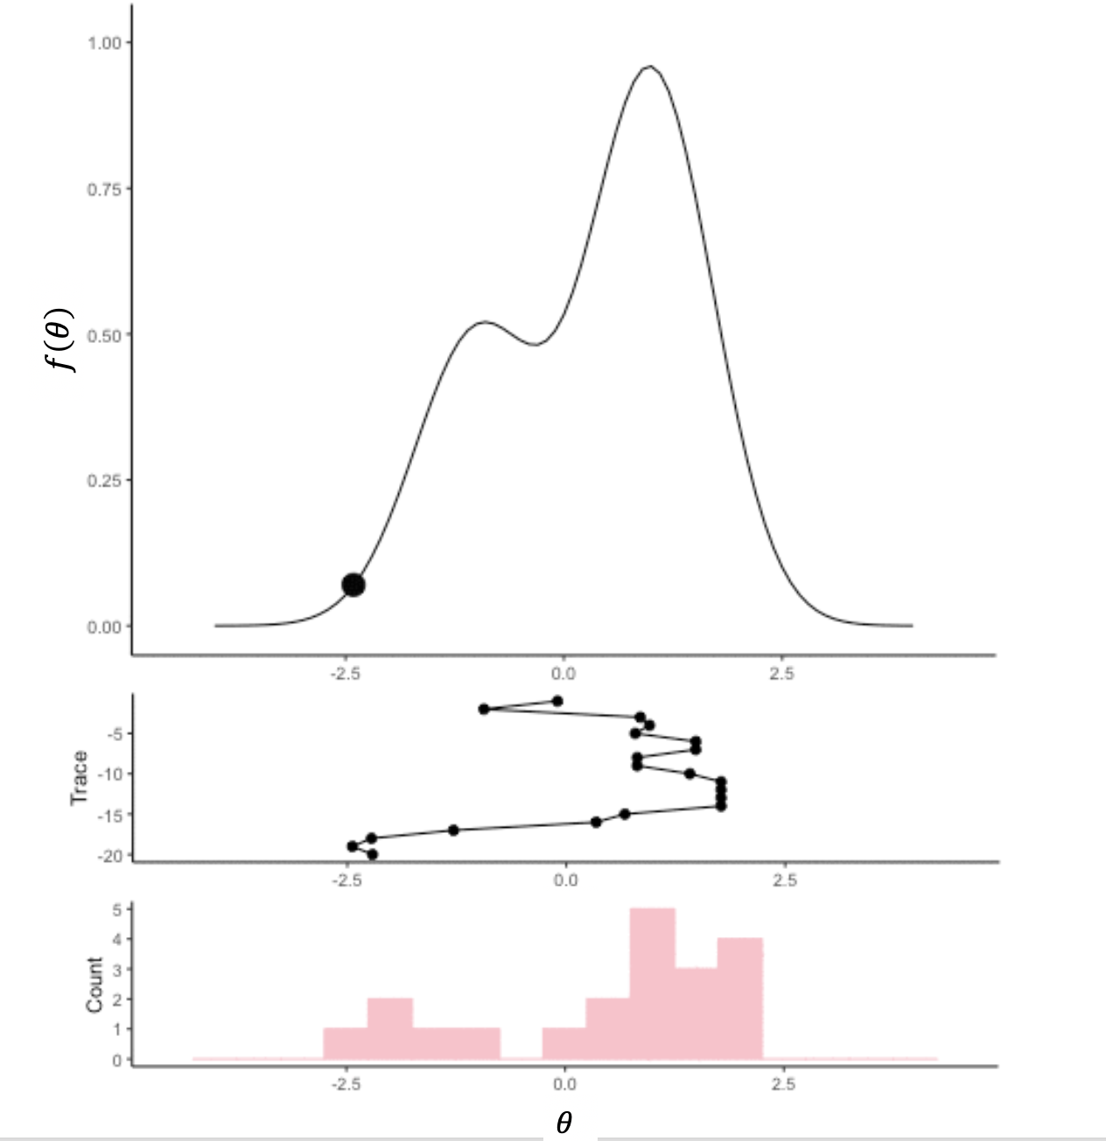

Slide 27
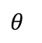
After enough iterations…
$$θ$$
Notes:
Pause – for understanding. Rest of lecture is zooming out to show why it works, following the historical exposition.

Slide 28
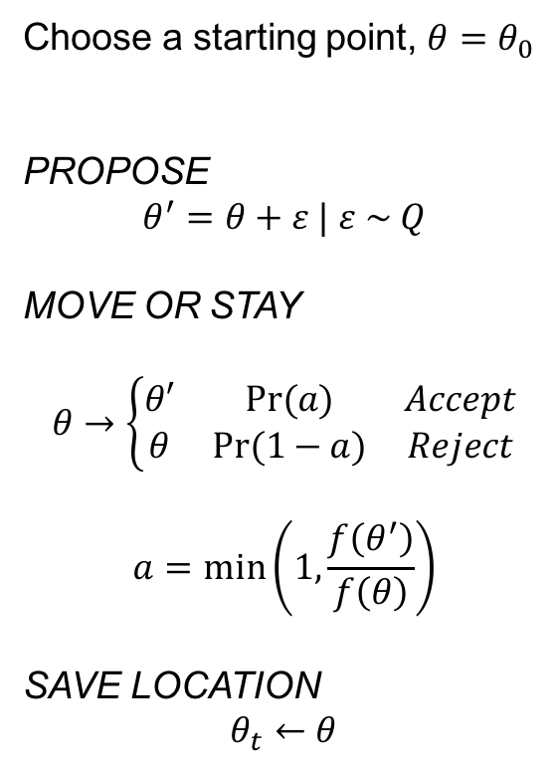
Practical, part 2
Choose a starting point, $θ=θ_{0}$
PROPOSE
$$θ^{′}=θ+ε | ε \sim Q$$
MOVE OR STAY
$$θ→\left\{\begin{matrix}θ′ & Pr⁡(a) & Accept \\ θ & Pr⁡(1−a) & Reject\end{matrix}\right.$$
$$a=\min\left(1,\frac{f\left(θ^{′}\right)}{f\left(θ\right)}\right)$$
SAVE LOCATION
$$θ_{t}←θ$$
$$f\left(θ\right)$$
$$θ$$
PROPOSE
MOVE OR STAY (“acceptance”)
SAVE LOCATION

Slide 29
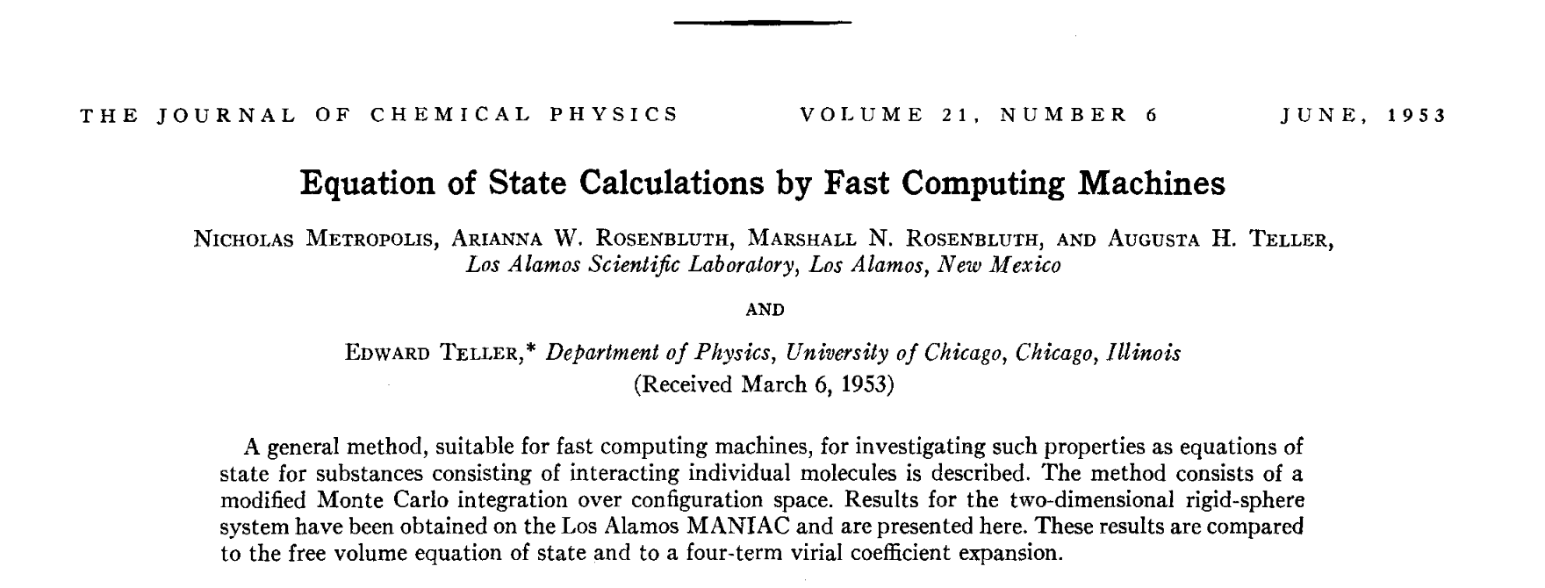
Why does MCMC with Metropolis-Hastings converge to the target distribution?
Notes:
to avoid intimidation

Slide 30
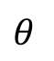
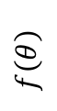
A sloppy hill-climbing algorithm
$$f\left(θ\right)$$
$$θ$$

Slide 31
A thought experiment…
A
B
How does the dye “know” to stop flowing?
Notes:
Discuss freezing & reporting versus a single particle

Slide 32
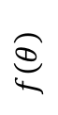
Let’s zoom in on the posterior distribution:
$$f\left(θ\right)$$
$$θ$$

Slide 33
Let’s zoom in on the posterior distribution:
$$f\left(θ\right)$$
$$θ$$

Slide 34
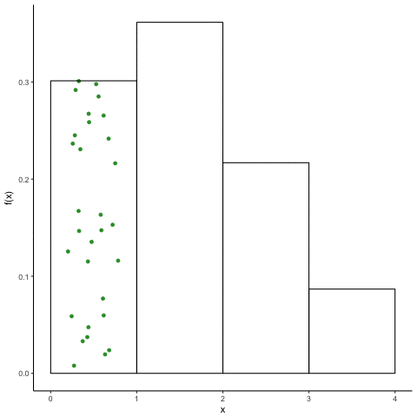
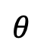
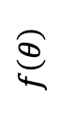
Suppose we have molecules of “dye” diffusing through a container shaped like the posterior distribution
Here the molecules are moving in discrete time steps
We will show that if these molecules move according to the Metropolis acceptance ratio, their locations converge to “match” the posterior distribution
$$f\left(θ\right)$$
$$θ$$

Slide 35
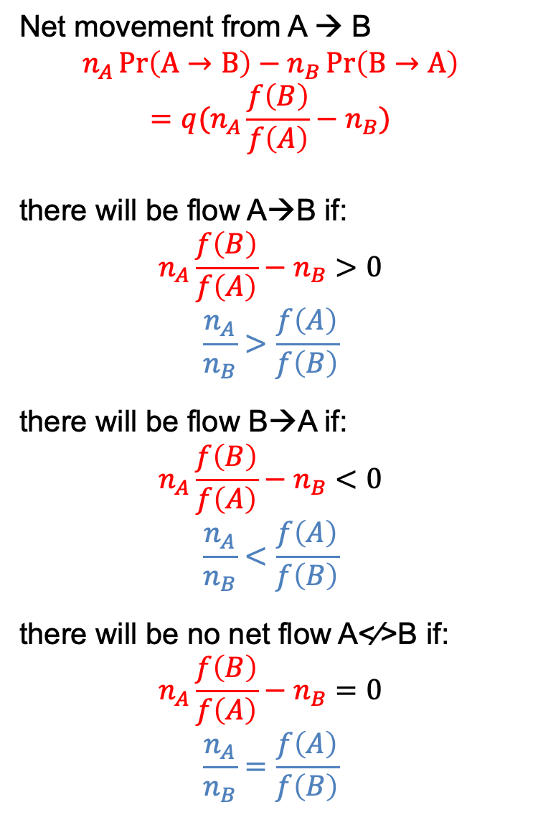
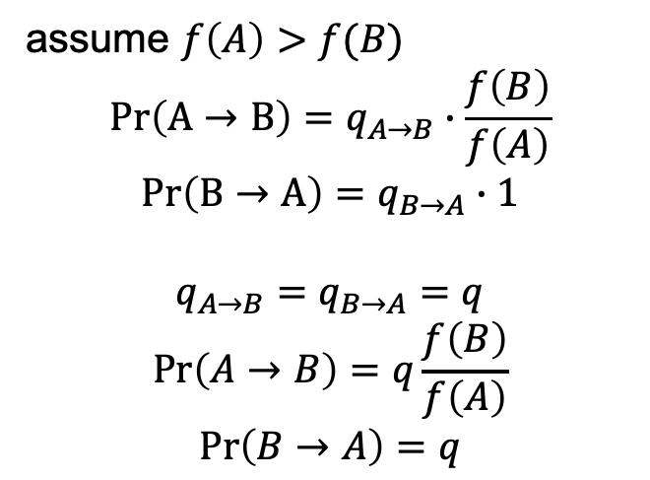
Net movement from A → B
$$n_{A}\operatorname{Pr}\left(A→B\right)−n_{B}\operatorname{Pr}\left(B→A\right)$$
$$=q(n_{A}\frac{f\left(B\right)}{f\left(A\right)}−n_{B})$$
there will be flow A→B if:
$$n_{A}\frac{f\left(B\right)}{f\left(A\right)}−n_{B}>0$$
$$\frac{n_{A}}{n_{B}}>\frac{f\left(A\right)}{f\left(B\right)}$$
there will be flow B→A if:
$$n_{A}\frac{f\left(B\right)}{f\left(A\right)}−n_{B}<0$$
$$\frac{n_{A}}{n_{B}}<\frac{f\left(A\right)}{f\left(B\right)}$$
there will be no net flow A<⁄>B if:
$$n_{A}\frac{f\left(B\right)}{f\left(A\right)}−n_{B}=0$$
$$\frac{n_{A}}{n_{B}}=\frac{f\left(A\right)}{f\left(B\right)}$$
n_{A}
f(A)
f(B)
n_{B}
A
B
assume $f\left(A\right)>f(B)$
$$\operatorname{Pr}\left(A→B\right)=q_{A→B}∙\frac{f\left(B\right)}{f\left(A\right)}$$
$$\operatorname{Pr}\left(B→A\right)=q_{B→A}∙1$$
$$q_{A→B}=q_{B→A}=q$$
$$\operatorname{Pr}\left(A→B\right)=q\frac{f\left(B\right)}{f\left(A\right)}$$
$$\operatorname{Pr}\left(B→A\right)=q$$

Slide 36


$$f\left(θ\right)$$
$$θ$$

Slide 37
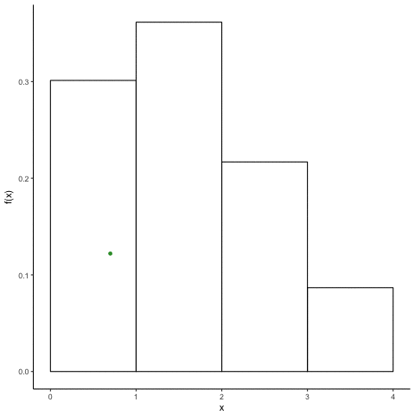
$$f\left(θ\right)$$
$$θ$$

Slide 38
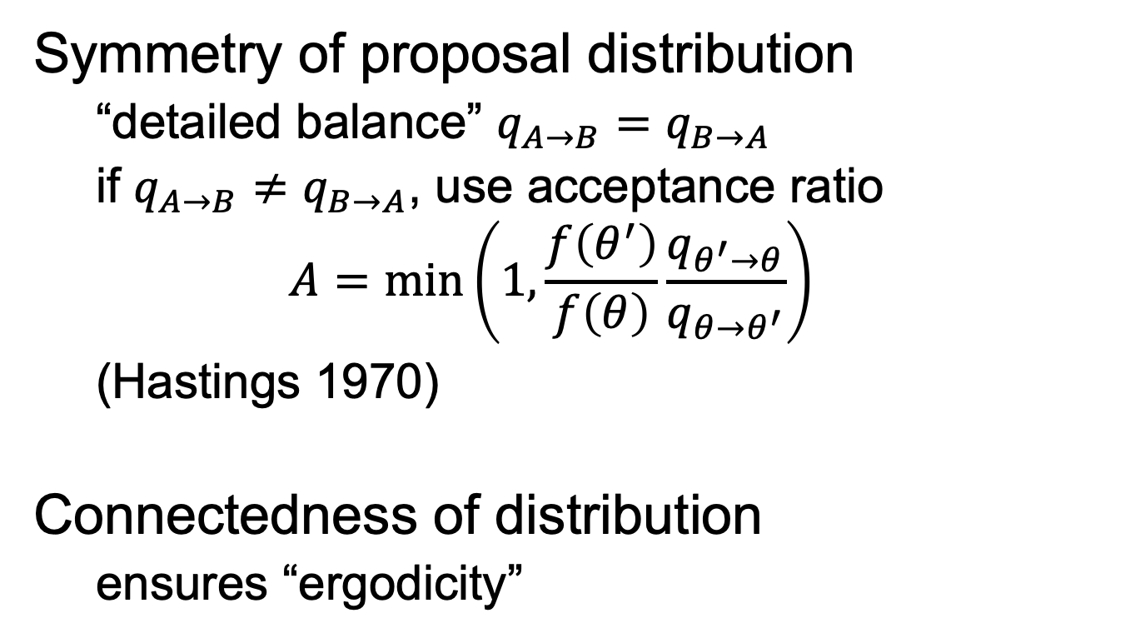
Requirements
Symmetry of proposal distribution
“detailed balance” $q_{A→B}=q_{B→A}$
if $q_{A→B}≠q_{B→A}$, use acceptance ratio
$$A=\min\left(1,\frac{f\left(θ^{′}\right)}{f\left(θ\right)}\frac{q_{θ^{′}→θ}}{q_{θ→θ^{′}}}\right)$$
(Hastings 1970)
Connectedness of distribution
ensures “ergodicity”

Slide 39
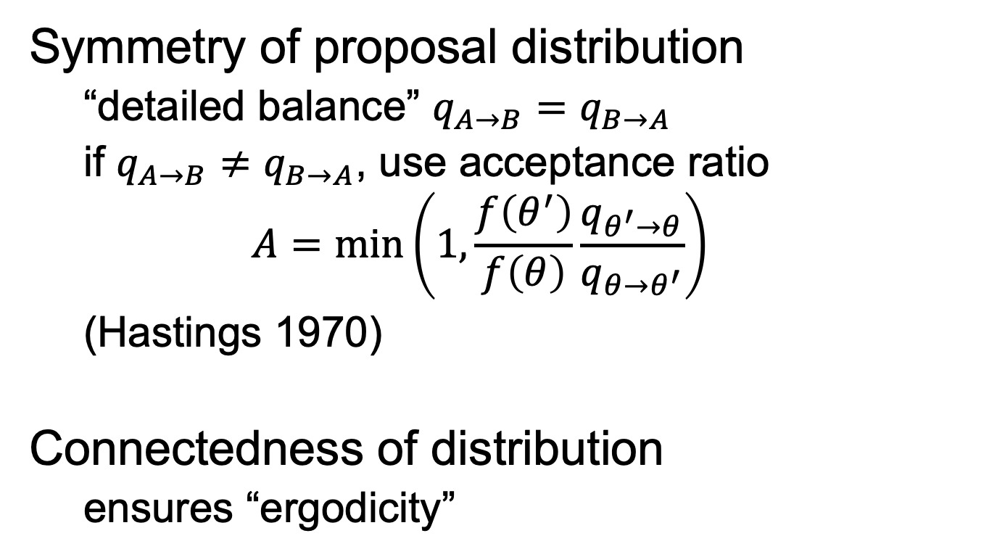

Requirements
Symmetry of proposal distribution
“detailed balance” $q_{A→B}=q_{B→A}$
if $q_{A→B}≠q_{B→A}$, use acceptance ratio
$$A=\min\left(1,\frac{f\left(θ^{′}\right)}{f\left(θ\right)}\frac{q_{θ^{′}→θ}}{q_{θ→θ^{′}}}\right)$$
(Hastings 1970)
Connectedness of distribution
ensures “ergodicity”
Metropolis-
Hastings

Slide 40
MCMC algorithm
Choose a starting point, $θ=θ_{0}$
PROPOSE
$$θ^{′}=θ+ε | ε \sim Q$$
MOVE OR STAY
If $f\left(θ^{′}\right)>f(θ)$, definitely move.
If $f\left(θ^{′}\right)<f(θ)$, move with probability $f(θ^{′})/f(θ)$, otherwise stay.
$$f\left(θ\right)$$
$$θ$$
PROPOSE
MOVE OR STAY (“acceptance”)
SAVE LOCATION
Notes:
three steps first

Slide 41
MCMC algorithm
Choose a starting point, $θ=θ_{0}$
PROPOSE
$$θ^{′}=θ+ε | ε \sim Q$$
MOVE OR STAY
$$θ→\left\{\begin{matrix}θ′ & Pr⁡(a) & Accept \\ θ & Pr⁡(1−a) & Reject\end{matrix}\right.$$
$$a=\min\left(1,\frac{f\left(θ^{′}\right)}{f\left(θ\right)}\right)$$
SAVE LOCATION
$$θ_{t}←θ$$
$$f\left(θ\right)$$
$$θ$$
PROPOSE
MOVE OR STAY (“acceptance”)
SAVE LOCATION

